Slide 1
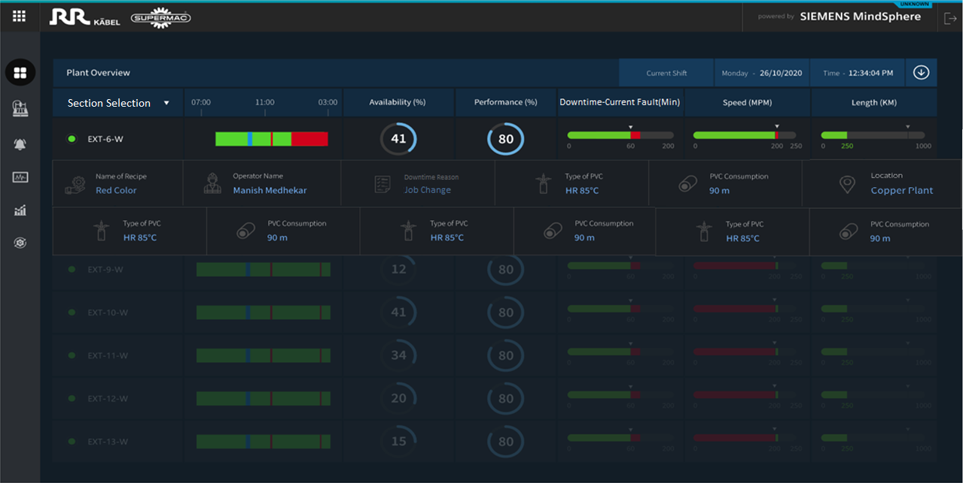
Overview Screen

Slide 2
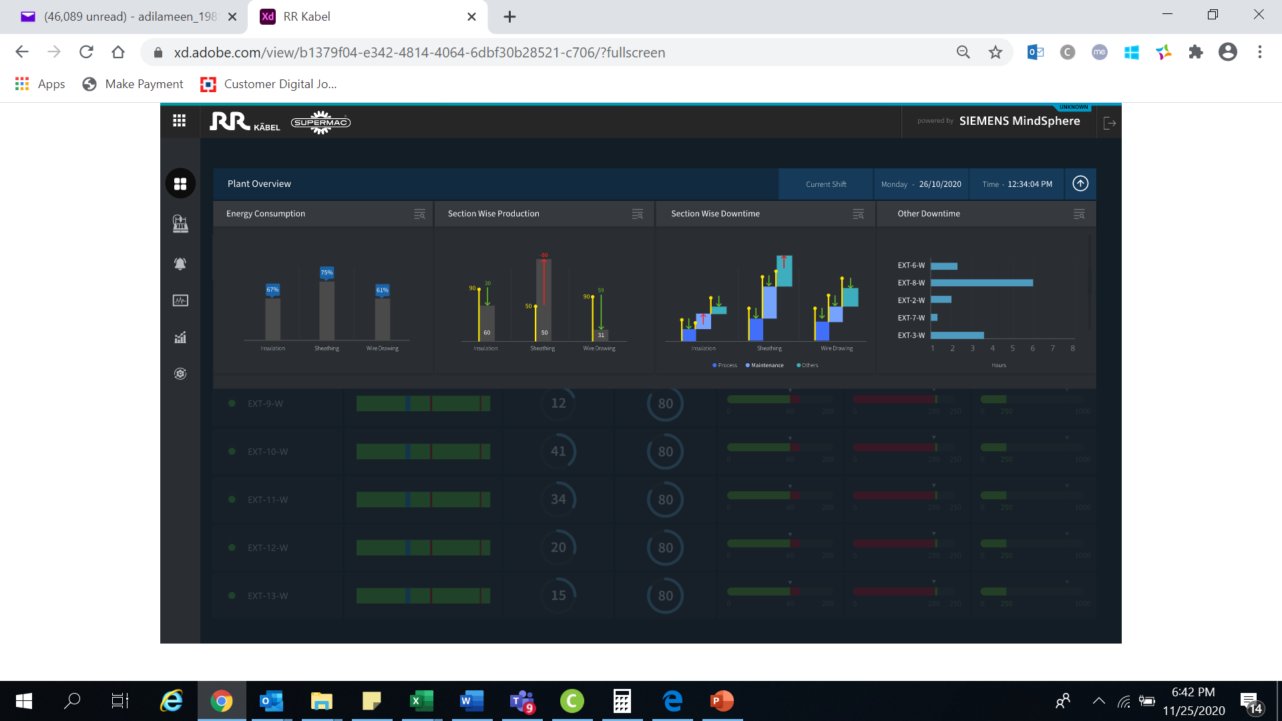
Overview Screen…Conti

Slide 3
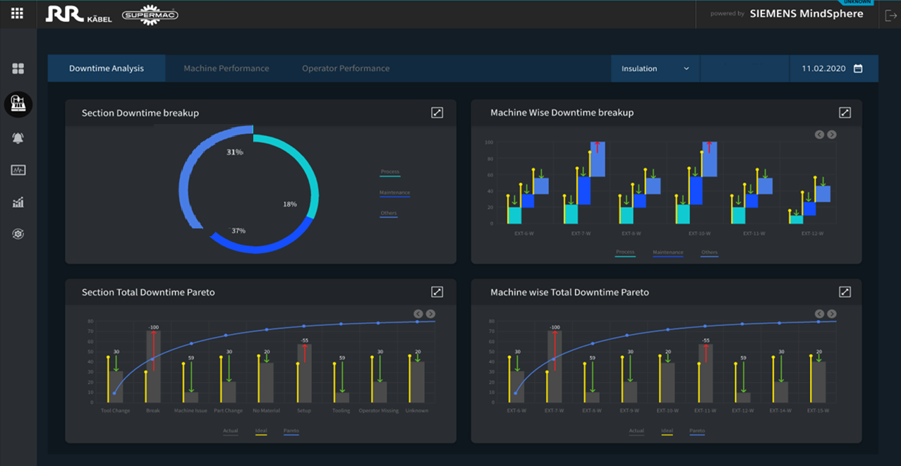
Downtime Analysis – Section Wise

Slide 4
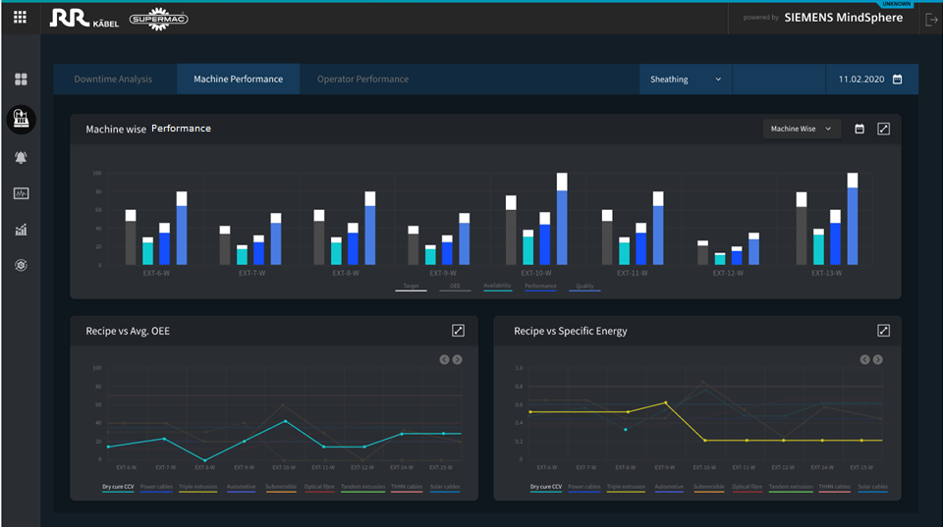
Machine Analysis– Section Wise

Slide 5
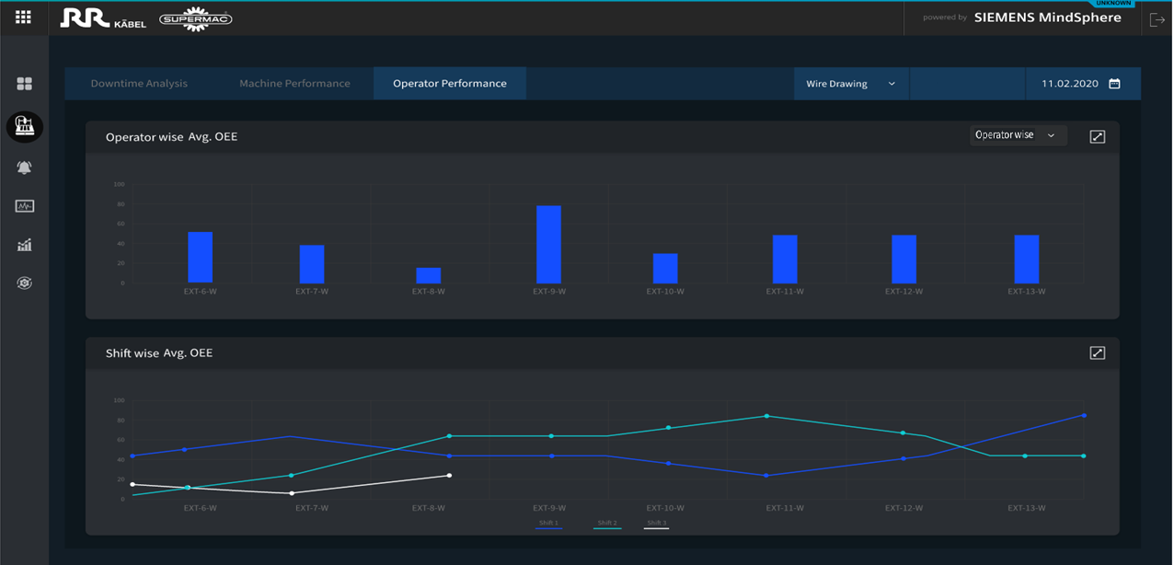
Operator Performance– Section Wise

